Slide 1


Slide 2
Targeted Billboard Advertising
Noman Shafi 164386
Raffey Nasser 164007
Bilal Zumar 166347
Zaheer Ud Din Faiz 164230

Slide 3
Project type and problem statement
Our project is actually a marketing application leveraging AI and computer vision techniques.
Businesses spend far too much money on inefficient advertisement strategies.
Sometimes they address the wrong audience.
When running ads on outside sites and apps, it’s much harder to prevent unfavorable adjacencies, or to reach engaged users who are likely to dwell on an image for more than a split second.

Slide 4
Some observations...
A survey conducted by Gumgum, Inc shows the following observations:
42 percent of marketers said that insufficient viewability challenged their ability to raise brand awareness.
48 percent of marketers said that insufficient viewability was a challenge when it came to driving e-commerce.
41 percent of marketers said that contextual irrelevance was their biggest concern in terms of getting users to engage with content.
46 percent said contextual irrelevance was their biggest overall concern when it came to generating revenue.

Slide 5
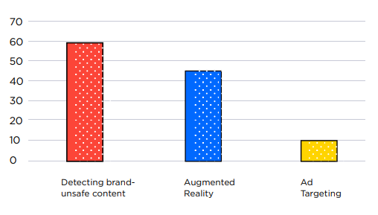
… and some figure(s)
Figure 1: How marketers currently use Computer Vision technology

Slide 6
An interesting observation
Ad targeting was pegged to have secured 2.7 times as much revenue as non-targeted ads, as shown by a study conducted in 2009 by the Network Advertising Initiative.

Slide 7
Goals (how we address this issue)
Allow advertisers and marketers to reduce resource costs by minimizing wasted advertisements to uninterested consumers.
The product should serve ads to only those who are likely to patronize their products or services.
The product should allow to captivate the attention of consumers they were aimed at with respective ads resulting in higher return on investment for the concerned party.

Slide 8
Goals (how we address this issue)
The system will utilize face detection, gender and age prediction algorithms.
After detecting faces, it will try to predict gender and age.
Age will fall into either one of a certain number of age groups and gender into either of two groups.
Afterwards, it will use all this information to display the relevant ad to the person.

Slide 9
Future goal(s)
Peak time analysis.
Total engagement time.
Total Ad display time.
Real time per Ad analysis.
Expressions of people.
Dashboard to view data and analytics in real time.

Slide 10
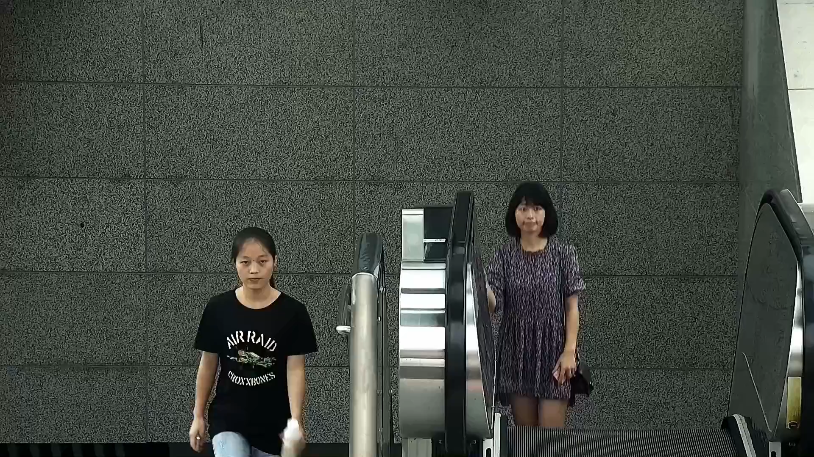
Face Detection (how it is done)

Slide 11
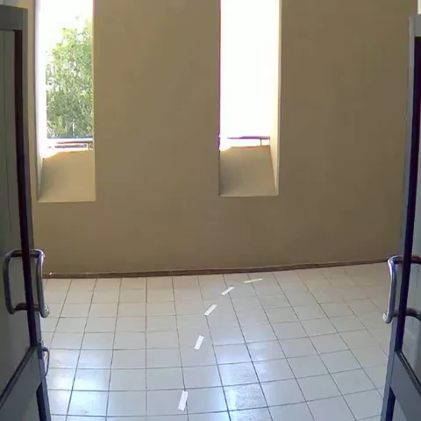
Gender Classification

Slide 12
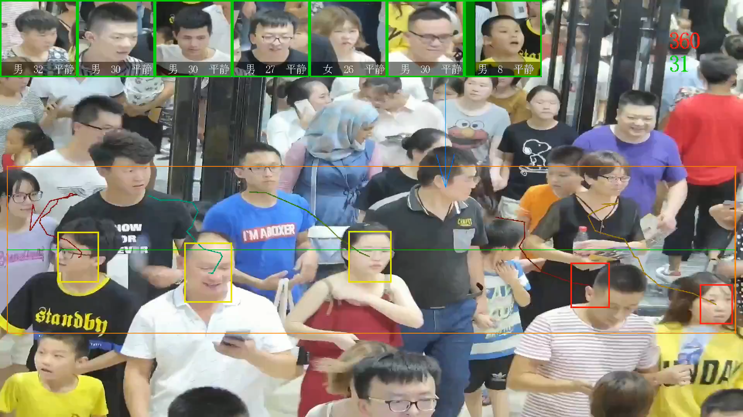
Age Prediction

Slide 13
Scope
Things we are going to do
Face Detection
Gender Classification
Age Classification
Web Application Development
Network Handling
Prioritising Ads Based on Payment
Displaying Targeted Advertisements
Time handling

Slide 14
Scope(cont.)
Things we are not going to do
Facial Expression Classification
Physical Appearance Classification
Transgender Classification
Multiple Mall Integration
Outdoor service

Slide 15
Overview
Stream of images captured through camera.
The images are fed to classifier (which are deploy on raspberry pi).
In raspberry pi stream of images classified on the basis of gender and age.
After that, raspberry pi request from central server for an ad.
Central server will respond depending upon the parameters provided i.e age and gender.
These ads will be displayed at the billboards.
Central server will also record time, age and gender for graphical representation on chart.

Slide 16
Overview
Hardware Requirements
Cameras
LEDs
Raspberry pi Devices
Server
Ethernet Cables
Networking Adapter
GPU

Slide 17
Overview
Software Requirements
Linux OS
Visual Studio Code
Tensorflow
Python 3.6.0

Slide 18
Constraints and Limitation
Issues with sample and selection
Insufficient sample size for statistical measurement
Methods used to collect data
Limited access to data
Time constraints

Slide 19
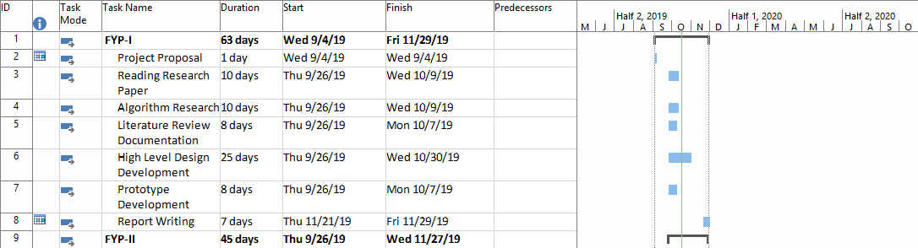
Project Timeline FYP-I

Slide 20
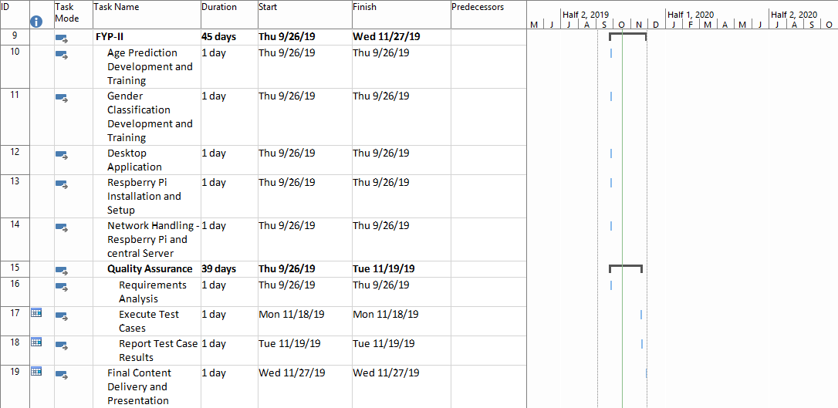
Project Timeline FYP-II

Slide 21


